Slide 1
Rating prediction using NLP
Submitted by
Mr.Amol Wakchaure
Intern Data Science

Slide 2
Problem statement
We have a client who has a website where people write different reviews for technical products. Now they are adding a new feature to their website i.e. The reviewer will have to add stars(rating) as well with the review. The rating is out 5 stars and it only has 5 options available 1 star, 2 stars, 3 stars, 4 stars, 5 stars. Now they want to predict ratings for the reviews which were written in the past and they don’t have a rating. So, we have to build an application which can predict the rating by seeing the review.

Slide 3
Data Collection
You have to scrape at least 20000 rows of data. You can scrape more data as well, it’s up to you. more the data better the model In this section you need to scrape the reviews of different laptops, Phones, Headphones, smart watches, Professional Cameras, Printers, Monitors, Home theater, Router from different ecommerce websites. Basically, we need these columns-
1) reviews of the product. 2) rating of the product. You can fetch other data as well, if you think data can be useful or can help in the project. It completely depends on your imagination or assumption

Slide 4
Data shape
The csv contains 33758 rows and 2 columns.
The columns are “review” and “rating”.
The name of csv file is “ratings”
The Dataset contains no outliers

Slide 5
Important Libraries
Pandas
Numpy
Matplotlib
NLTK
Stopwords

Slide 6
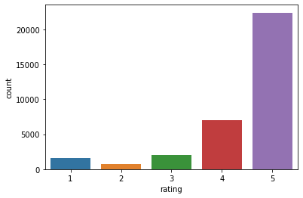
Univariate Analysis

Slide 7
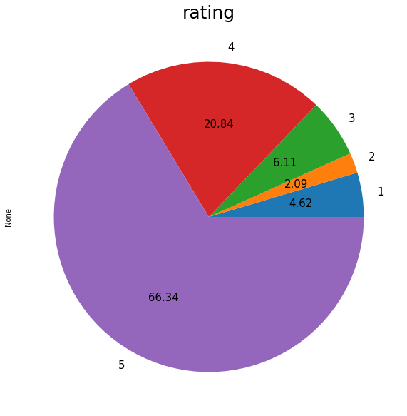
Univariate Analysis

Slide 8
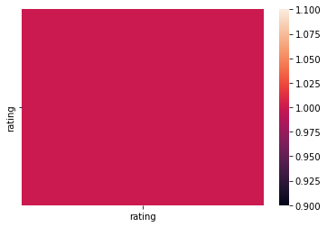
Multivariate Analysis

Slide 9
String length
By using below command , we can find exact length of each review comment.
ratings['length'] = ratings['review'].str.len()

Slide 10
String Operations
ratings['comment_text'] = ratings['review'].str.lower()
By using above command we converted all text into lowercase
We replaced all special symbols, numbers by space.
We also used stopwords to remove the stopwords from review text.

Slide 11
Stopwords
Stopwords are the words in any language which does not add much meaning to a sentence. They can safely be ignored without sacrificing the meaning of the sentence. For some search engines, these are some of the most common, short function words, such as the, is, at, which, and on.

Slide 12
New length
Total length removal
print ('Original Length', ratings.length.sum())
print ('Clean Length', ratings.clean_length.sum())
Original Length 2467261
Clean Length 2458443

Slide 13
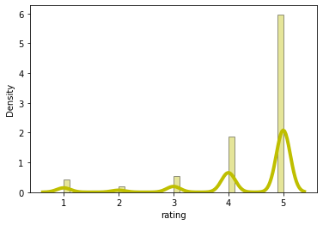
Histogram of ratings

Slide 14
Outlier removal
We used zscore method to remove outliers from datasets.
Original dataset contains 33758 after applying zscore we have 32200 rows.
We lost almost 5% data.

Slide 15
SMOTE
SMOTE is used for oversampling purpose.
By using this techniques we can equal all classes.
So the problem of imbalancing is removed

Slide 16
Algorithm
Logistic Regression.
Random Forest.
Decision Tree
AdaBoost
KNN

Slide 17
Testing Accuracy of Each model
Logistic Regression=71.79089026915114
Random Forest.=75.38302277432712
Decision Tree=71.5631469979296
AdaBoost =70.53830227743271
KNN=69.35817805383023

Slide 18
Cross Validation Score
Logistic Regression.=68.87893998677743
Random Forest.=68.05593942639399
Decision Tree=63.257813187117584
AdaBoost =68.56215909455796
KNN=66.06221454497904

Slide 19
Compare Accuracy score and CV score
Logistic Regression=71.790-68.878=2.912
Random Forest.=75.383-68.055=7.32
Decision Tree=71.563-63.257=8.30
AdaBoost =70.538-68.562=1.97
KNN=69.358-66.062=3.29

Slide 20
Best Model
Here we select Random forest as our best model, because we get highest accuracy and CV score for Random Forest.
It show more diffrence between accuracy and CV score but still RF is best model.

Slide 21
Hyperparameter Tuning
We passed following parameters
params={'n_estimators':[10,12,13],
'max_depth':[10,15],
'min_samples_leaf':[5,6],
}.
By passing above parameter we get improved accuracy 70.41%

Slide 22
Most frequent words
By using eli5, we get top 15 occuring words.
We used TF IDF vectorizer to do the same operation.
For that we used our RF model.

Slide 23
Model Saving
We saved our best Random Forest model called as “Rating prediction using NLP.pkl”.

Slide 24
Conclusion
In this project I have collected data of reviews and ratings for different products from flipkart.com.
Then I have done different text processing for reviews column and chose equal number of text from each rating class to eliminate problem of imbalance.
By doing different EDA steps I have analyzed the text. We have checked frequently occurring words in our data as well as rarely occurring words.
After all these steps I have built function to train different algorithms and using various evaluation metrics I have selected RF Classifier for our final model.
Finally by doing hyperparameter tuning we got optimum parameters for our final model. And finally we got good accuracy score for our final model.

Slide 25
Limitations
As we know the content of text in reviews is totally depends on the reviewer and they may rate differently which is totally depends on that particular person. So it is difficult to predict ratings based on the reviews with higher accuracies. Still we can improve our accuracy by fetching more data and by doing extensive hyperparameter tuning.

